Slide 1
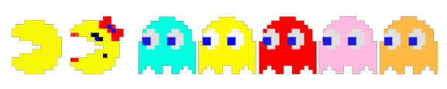
Reinforcement Learning
With Ms. Pac-Man
Laurel Bingham

Slide 2
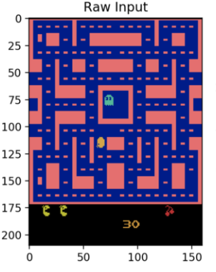
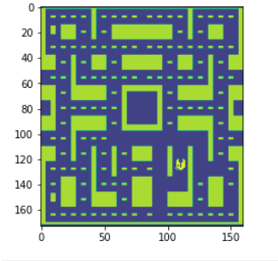
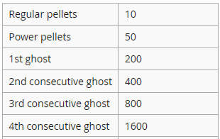
Why Ms. Pac-Man?
Raw Input
Processed Input
Original Reward Structure
In the original deepmind paper, Ms. Pac-Man failed to reach player benchmarks
The DQN was not tuned, instead sought to show effectiveness of a generalized approach
There is a need to find how the DQN approach can be adjusted to improve the play of it’s worst games

Slide 3
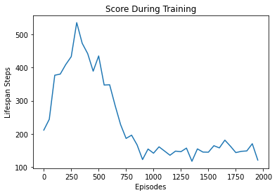
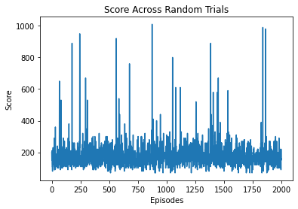
Methods
Random Play compared to DQN and DDQN
Minimum Randomness of 1% and 5% tested
Reward Structure Altered to Encourage Exploration
Trained for 2000 epochs with lr=.003 and Adam Optimizer
2 Agents trained per adjusted hyperparameter
Final average score after the minimum randomness was reached
DQN minimum randomness = 1%default reward

Slide 4
Results and Key Insights
Architecture | Minimum Randomness | Reward Structure | Average Score
DQN | 0.01 | default | 130
DQN | 0.05 | default | 150
DQN | 0.05 | adjusted (rewards of 0 changed to 9) | 190
DDQN | 0.01 | default | 200
DDQN | 0.01 | adjusted (rewards of 0 changed to 9) | 190
DDQN | 0.05 | adjusted (rewards of 0 changed to 9) | 230
Random Play | - | - | 180
Random play beat most DQN strategies
DDQN proved to be more robust, more frequently escaping the local minima
Forcing exploration with randomness was less helpful than forcing exploration with adjusted rewards

Slide 5
Observed Agent Behaviors
DDQN Base Reward, 1% Random
DDQN Base Reward, 5% Random
DDQN Adjusted Reward, 5% Random

Slide 6
Conclusion
Random agent can be beaten by learners with adjusted rewards
Highest scoring runs occurred around randomness at 30-40% while training
Learned strategy consistently fell short
The agents never learned to avoid ghosts - CNN may not detect them well

